Slide 1
Pizza Sales Analysis Dashboard
BY
SUDEEP KUMAR DAS
@ data_structure

Slide 2
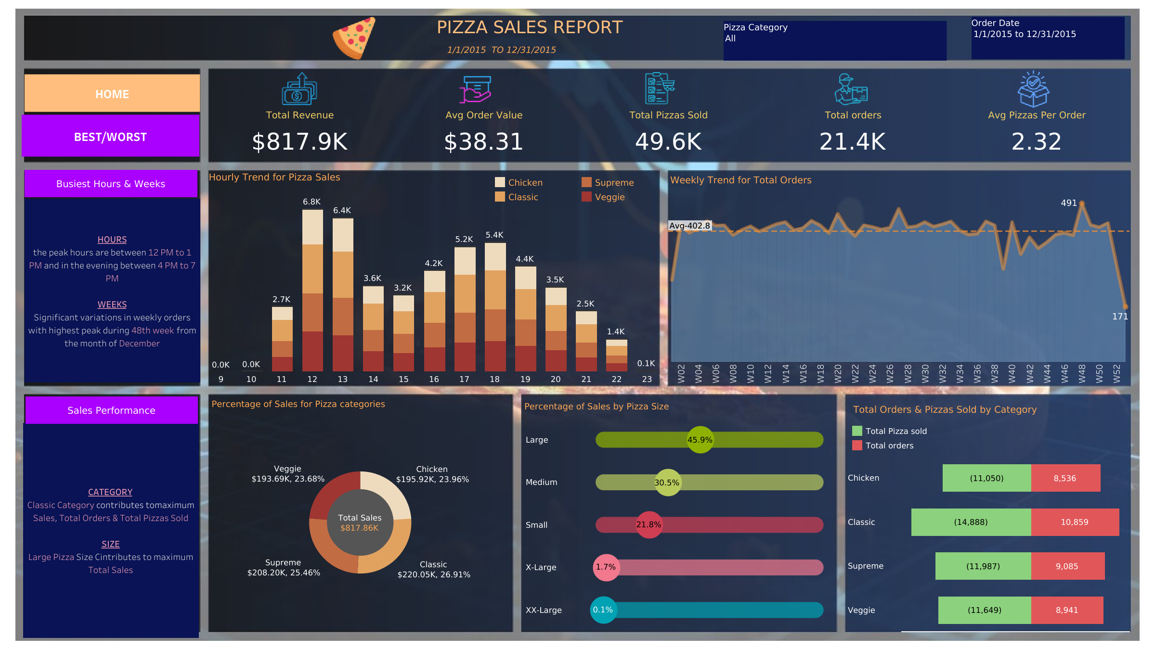

Slide 3
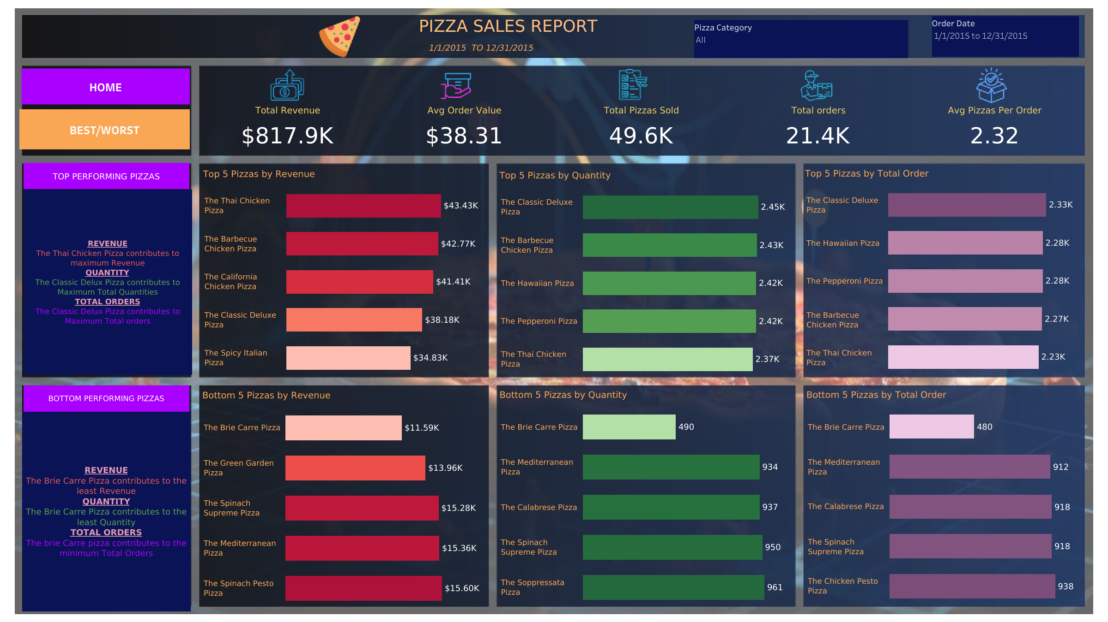

Slide 4
DASHBOARD DESIGNING
Being a Data analyst your task is to design a dynamic and interactive dashboard for your client using the pizza sales dataset. The following are the design elements:
Key performance indicators: a quantifiable measure of performance over time for a specific objective. The following are the KPI elements
A. Total Revenue
B. Average order value
c. total pizza sold (quantity)
d. total orders
e. average pizzas per order

Slide 5
Data visualisation (charts)
Visualise various parts of the dataset to extract actionable insights and key trends
2. Hourly trend of pizza sold: stacked bar chart displaying the hourly trend of the pizza sales. This will help us in identifying the trends in pizza sales on hourly basis.
3. Weekly trend of pizza sold: line chart displaying the weekly trend of the pizza sales. This will help us in identifying the trends in pizza sales on weekly basis and allocating essential resources.
4: sales by pizza category: create a pie chart indicating the distribution of pizza sales of different categories of the pizzas. This chart will help us identify the popularity of the different categories of pizzas.

Slide 6
5. Pizza sales by size: create a chart displaying the pizza sales by size. This will help us in identifying the popularity of the different pizza sizes.
6: total orders and total pizza sold by category: create a funnel chart displaying the total orders and the total quantity of pizzas sold with respect to the categories. This will allow us to compare the sales of different pizza categories.
2nd Page-
7: top 5 best sellers by revenue, quantity and total orders: a bar chart displaying the best selling pizzas based on revenue, total quantity ordered and total orders. This will help us in identifying the best pizzas.
8: bottom 5 pizzas by revenue, quantity and total orders: a bar chart displaying the bottom 5 selling pizzas based on revenue, total quantity ordered and total orders. This will help us in identifying the not so popular pizzas.

Slide 7

THANK YOU

